Slide 1
Introduction

Slide 2
Table of Contents
About Ansible
Installation
Configuring Ansible
Ansible Concepts
ad-hoc Commands

Slide 3

1
About Ansible

Slide 4
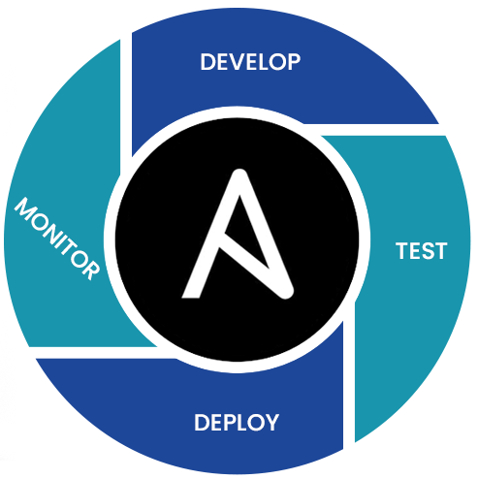
About Ansible
Ansible is an open-source IT automation tool. It can configure systems, deploy software, and orchestrate more advanced IT tasks such as continuous deployments.

Slide 5




About Ansible
Time
Simple
Coding Skills
Powerfull
Maintenance
Agentless
Scripts

Slide 6
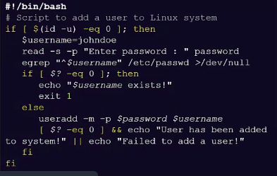
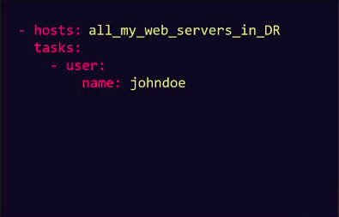
About Ansible
Scripts
Playbook

Slide 7
About Ansible
SIMPLE
POWERFULL
AGENTLESS
Human readable automation
No special coding skills needed
Tasks executed in order
Get productive quickly
App deployment
Configuration management
Workflow orchestration
Orchestrate the app lifecycle
Agentless architecture
Uses Open SSH
No agents to exploit or update
More efficient & more secure

Slide 8
2
Installation

Slide 9

Installation
We can install Ansible using yum and apt package managers.
For install with yum:
sudo yum install ansible -y
sudo dnf install ansible -y
For install with apt:
sudo apt-get -y install ansible

Slide 10

3
Configuring Ansible

Slide 11
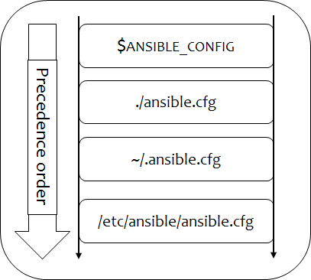
Configuring Ansible
Ansible supports several sources for configuring its behavior, including a file named ansible.cfg, environment variables, command-line options, playbook keywords, and variables.
Certain settings in Ansible are adjustable via a configuration file (ansible.cfg).
Changes can be made and used in a configuration file which will be searched for in the following order:
Notes:
$ANSIBLE_CONFIG=/home/ubuntu/deploy-ansible/ansible.cfg

Slide 12
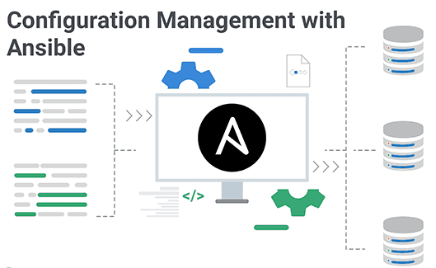
4
Ansible Concepts
Notes:
Understanded WHY? Now We will understand HOW?

Slide 13
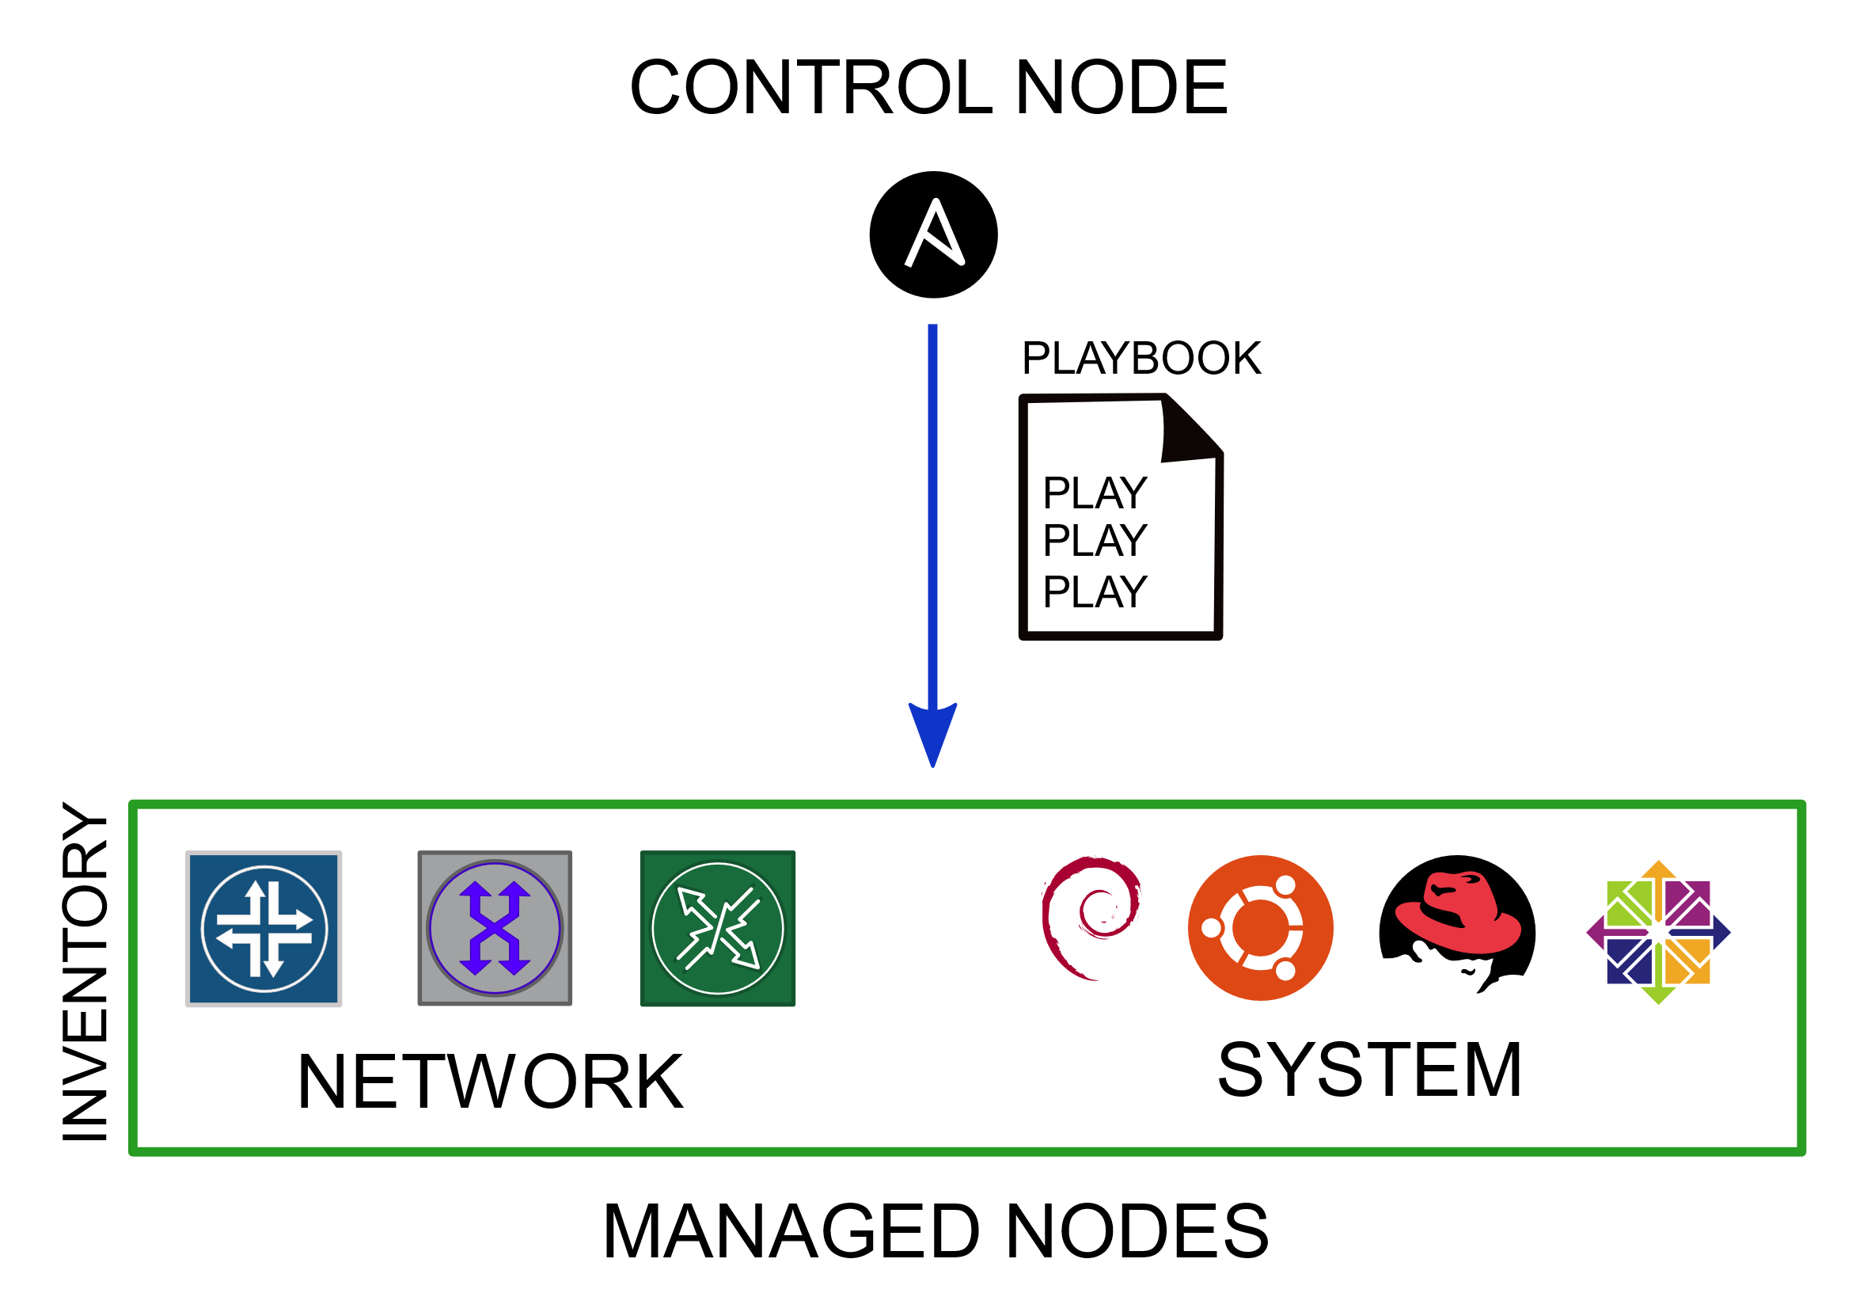
Ansible Concepts
Control node:
Any machine with Ansible installed. You can run commands and playbooks, invoking /usr/bin/ansible or /usr/bin/ansible-playbook, from any control node. You can use any computer that has Python installed on it as a control node - laptops, shared desktops, and servers can all run Ansible. However, you cannot use a Windows machine as a control node.

Slide 14
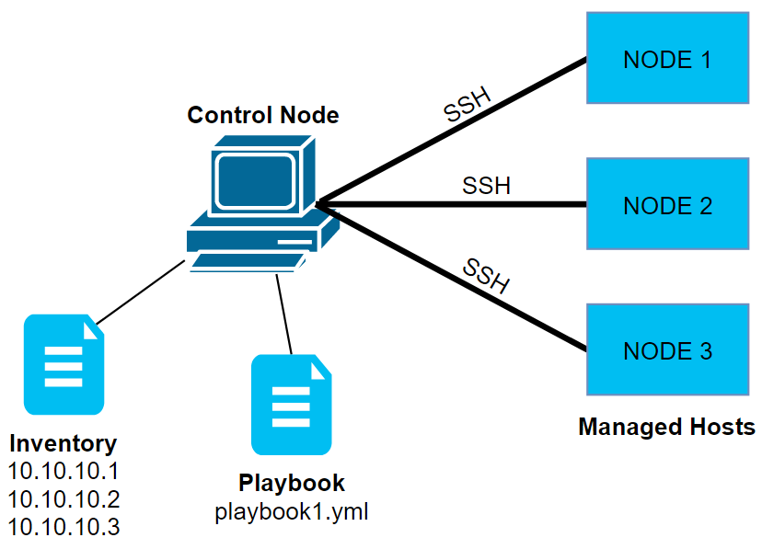
Ansible Concepts
Managed Nodes:
The network devices (and/or servers) you manage with Ansible. Managed nodes are also sometimes called hosts. Ansible is not installed on managed nodes.

Slide 15
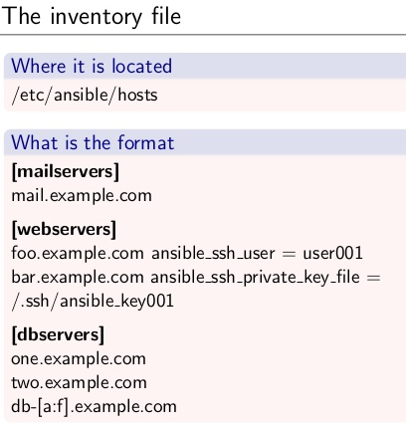
Ansible Concepts
Inventory:
A list of managed nodes. An inventory file is also sometimes called a hostfile. Your inventory can specify information like IP address for each managed node. An inventory can also organize managed nodes, creating and nesting groups for easier scaling.

Slide 16
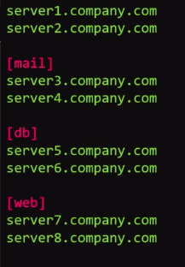



Ansible Concepts
Inventory
Linux - SSH
WinRM- (Windows Remote Management)
inventory
Agentless
/etc/ansible/hosts

Slide 17
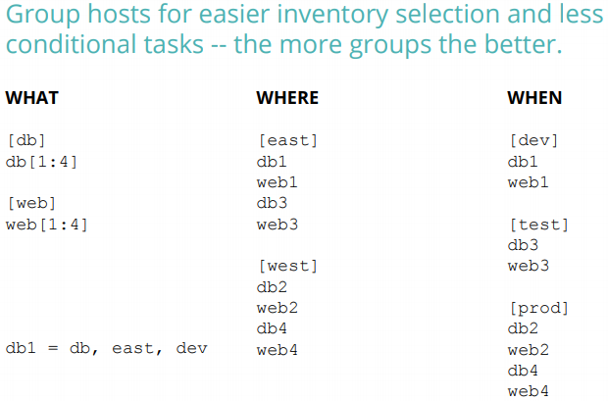
Ansible Concepts

Slide 18
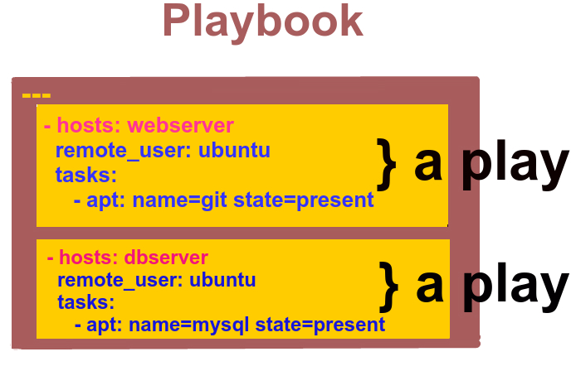
Ansible Concepts
Playbooks:
Ordered lists of tasks, saved so you can run those tasks in that order repeatedly. Playbooks can include variables as well as tasks. Playbooks are written in YAML and are easy to read, write, share and understand.

Slide 19
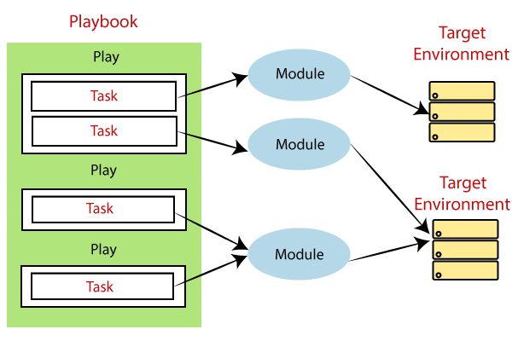
Ansible Concepts
Tasks:
The units of action in Ansible. You can execute a single task once with an ad-hoc command.

Slide 20
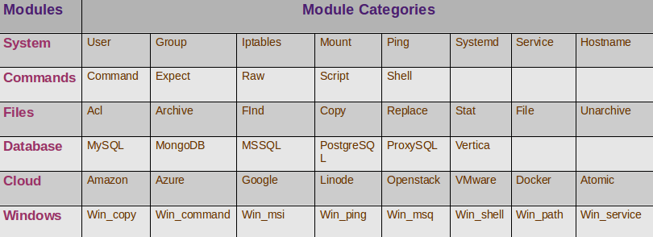
Ansible Concepts
Modules:
The units of code Ansible executes. Each module has a particular use, from administering users on a specific type of database to managing VLAN interfaces on a specific type of network device.

Slide 21
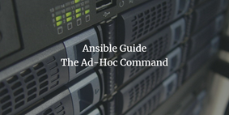
5
ad-hoc Commands

Slide 22
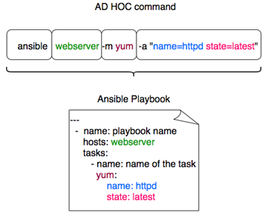
ad-hoc Commands
•An Ansible ad-hoc command uses the /usr/bin/ansible command-line tool to automate a single task on one or more managed nodes.
•Ad-hoc commands are quick and easy, but they are not reusable.
•Ad-hoc commands demonstrate the simplicity and power of Ansible.
•Ad-hoc commands are great for tasks you repeat rarely.

Slide 23
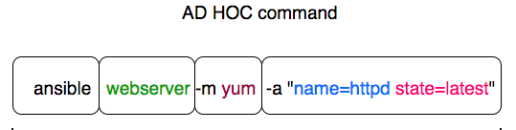
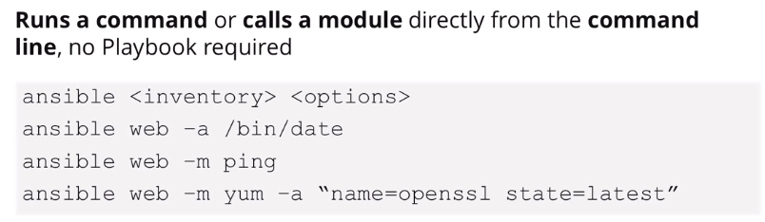
ad-hoc commands
ansible <inventory> -m

Slide 24
THANKS!
Any questions?

